Slide 1


Introduction to Software Engineering & Software Testing Life Cycle
Notes:
©2016 Capgemini. All rights reserved. The information contained in this document is proprietary and confidential. For Capgemini only.

Slide 2
Document History
Date | Course Version No. | Software Version No. | Developer / SME | Reviewer(s) | Approver | Change Record Remarks
21-May-2013 | 0.1D |  | Latha S
2-Sep-2013 | 1.0 |  | Latha S |  |  | Incorporated Review comments
June-2016 | 1.1 |  | Amruta Rakhonde & Shilpa Bhosle | Shilpa Bhosle | Mahima Sharma | Post-Integration revamp
July-2016 | 1.1 |  | Anjulata |  |  | Refinements

Slide 3
Course Goals and Non Goals
Course Goals
To provide an overview of software engineering
To provide an overview of software testing life cycle
Course Non Goals
This course is only an introductory course to Software engineering and software testing life cycle.
This course does not intend to delve into details on activities involved in phases like requirements, high level design etc.

Slide 4
Pre-requisites
There are no pre-requisites for this course.

Slide 5

Intended Audience
New entrants to the organization (Fresher’s batches)

Slide 6
Objective
To Understand the following :
What is Software Engineering (SE)
Common life cycle models
Phases in SE
Familiarizing Requirements Phase
Familiarizing Design Phase
Familiarizing Construction Phase
Familiarizing Testing and acceptance Phase
Review and Configuration Management Process
Notes:
Tell the participants that we are just briefly touching these topics for their general awareness purpose. Some of these topics have a separate training program of their own.

Slide 7
Objective
To Understand the following :
What is Software Quality?
Other definitions
Quality Assurance & Quality Control
Importance of QA/QC
What is V&V?
Static and Dynamic V&V
Static and Dynamic Techniques
Why V&V?
Types of V&V
Notes:
Tell the participants that we are just briefly touching these topics for their general awareness purpose. Some of these topics have a separate training program of their own.

Slide 8
Objective
To Understand the following :
What is Life Cycle ?
Software Testing Lifecycle
Different tasks involved in STLC
Different activities in each tasks
Task 1: Sales & Initial Planning
Task 2: Create Test Strategy
Task 3: Analyze and Design Testware
Task 4: Test execution and analysis
Notes:
Tell the participants that we are just briefly touching these topics for their general awareness purpose. Some of these topics have a separate training program of their own.

Slide 9
Introduction to Software Engineering

Slide 10
Overview of the Session
What is Software Engineering?
Software Development Life Cycle
Software development Models
Life cycle selection

Slide 11
Software Engineering – What
A systematic , disciplined and measurable approach towards development, operation and maintenance of a software
Concerned with creating and maintaining software applications by applying technologies and practices from
Computer science,
Project management,
Engineering,
Application domains etc..
It is broad term covering not only the technical aspects of building software , but also other factors like team management, schedule, budget and resource management etc..
Notes:
Typical other formal definitions of software engineering are
"an engineering discipline that is concerned with all aspects of software production"
"the establishment and use of sound engineering principles in order to economically obtain software that is reliable and works efficiently on real machines“
Traditional engineers use science to construct “real” artifacts and software engineers use mathematics, science to construct “abstract” artifacts
In layman terms it is application of engineering towards development of a software

Slide 12
Software Development Life Cycle (SDLC)
Also known as software development process or Systems development life cycle
A set of processes, standards and tools used to develop, alter software in a optimal manner
Starts when a product is conceived and ends when the product is no longer available or is effective to use
Composed of phases , where each phase is dependent on the previous phase’s result
Each phase is a limited period of time starting with a definite set of data and having a definite set of results
Notes:
Also known as systems development life cycle (SDLC), or software development process, or Software Development Life Cycle
It is a process of creating or altering information systems using various models and methodologies The SDLC aims to produce a high quality system that meets or exceeds customer expectations, reaches completion within times and cost estimates, works effectively and efficiently
The SDLC framework provides a sequence of activities for system design and development . It consists of a set of steps or phases in which each phase of the SDLC uses the results of the previous one.
.

Slide 13
Typical Phases in Software Development
Feasibility
Feasibility study
Coding
Implementation
Strategy planning
Unit Test
Requirements
Elicitation
Testing
Component
SRS
Integration
Analysis
Deployment
Installation
Design
System
Maintenance
Detailed design
document
Operations
Support
Retirement
Notes:
Activities during phases
Requirements: establish the customer’s needs
System Design: develop the system’s structure
Detailed Design: develop module structures
Implementation: code or otherwise
Testing: check what’s been developed
Installation: bring the system into production
Maintenance: correct, adapt, improve

Slide 14
SDLC Models
A life cycle model covers the entire lifetime of a software – from birth of an idea to phase out
More than one possible life cycle models can be adopted
The type of SDLC model is defined by the way it links the phases.
Every life cycle focusses its phase towards a goal and has a definite milestone
Some of the common developmental models defined are
Waterfall /Enhanced Waterfall
V – model
Evolutionary Prototyping (aka Incremental)
Throw-away Prototyping (aka Rapid))
Incremental
Following models are typically used in the organisations Iterative , V-model , Agile and semi waterfall
Notes:
A (software/system) lifecycle model is a description of the sequence of activities
carried out in an SE project, and the relative order of these activities.
Provides a generic framework for various activities to be done for the lifetime of the s/w - design, develop and maintain
More than 1 model can be chosen or models can be changed between releases of the s/w

Slide 15
Software Development Models- Waterfall
Requirements
Design
Construction
Testing
Roll out
Maintenance
Notes:
Waterfall processes
The waterfall model is a sequential software development model in which development is seen as flowing steadily downwards (like a waterfall) through the phases of requirements analysis, design, implementation, testing (validation), integration, and maintenance.
To follow the waterfall model, one proceeds from one phase to the next in a purely sequential manner. For example, one first completes "requirements specification" — they set in stone the requirements of the software.When and only when the requirements are fully completed, one proceeds to design. The software in question is designed and a "blueprint" is drawn for implementers (coders) to follow — this design should be a plan for implementing the requirements given. When and only when the design is fully completed, an implementation of that design is made by coders. Towards the later stages of this implementation phase, disparate software components produced by different teams are integrated.
After the implementation and integration phases are complete, the software product is tested and debugged; any faults introduced in earlier phases are removed here. Then the software product is installed, and later maintained to introduce new functionality and remove bugs.
Thus the waterfall model maintains that one should move to a phase only when its preceding phase is completed and perfected. Phases of development in the waterfall model are thus discrete, and there is no jumping back and forth or overlap between them.
Typically Waterfall model is chosen when requirements , development environment and technology are well known and is more or less permanent

Slide 16
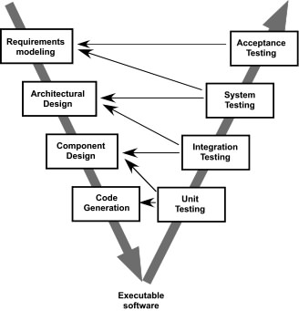
Software Development Models – V Model
Notes:
It is also known as Verification and Validation model .
This is a SDLC model which emphasizes the verification and validation of the product. The quality assurance activities are performed in the each phase of Software Testing Life Cycle phase. Based on the requirement document both development team and testing team start their activities in parallel . The developer team started working on the design and after completion on design start actual implementation . The testing team in parallel starts working on test planning, test case writing, test scripting..
Main focus in V mode l is proactive defect tracking and avoiding the downward flow of defects . However though this model helps in planning for Verification and Validation in early stages of product development , it cannot handle the following
concurrent events
dynamic changes in requirements
risk analysis and feedback to the previous iteration
V-Model is ideal for projects where requirements are well known upfront , needs very high level of reliability and is of small size
Instructor Note :
Since both testing and development are done in parallel , there is always a discussion whether it is testing or developmental model

Slide 17
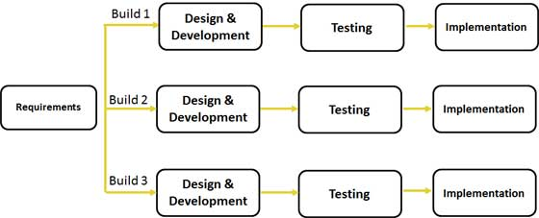
Software Development Models – Iterative and Incremental
Notes:
The iterative and incremental model (IID) method of s/w development is to build the s/w in a incremental way . Every increment will involve analyzing requirements , design , code , test , deploy iteratively adding a little more to the product until the whole product is finished.
The basic idea behind iterative enhancement is to develop a system incrementally, allowing the development team to take advantage of what was being learned during the development of earlier, incremental, deliverable versions of the system. Learning comes from both the development and use of the system, where possible.
Key steps in the process were to start with a simple implementation of a subset of the software requirements and iteratively enhance the evolving sequence of versions until the full system is implemented. At each iteration, design modifications are made and new functional capabilities are added.
The goal for the design and implementation of any iteration is to be simple, straightforward, and modular, supporting redesign at that stage
Note : Fixing defects identified is NOT an iteration. Every iteration has a concrete deliverable and undergoes all the phases . Requirement prioritization helps in deciding the deliverables in each iteration . For example we may deliver web interface in first iteration and mobile interface in second iteration
This model is suitable for projects having evolving requirements , need to get to market early . Lengthy schedule and new technologies .
Instructor Notes
Explain that there are many types of incremental model UP, RUP etc .

Slide 18
Agile Modeling
It is a variant of the Incremental model
It enables developing customized software with a process that helps in meeting current requirement as well as future through suitable adjustment
The following principles that enable this methodology to be effective and light weight
Communication
Open communication between stakeholder and development team at every stage
Simplicity
The model emphasize the need to keep concepts and ideas in simple manner like simple tools , simple design , content etc..
Feedback
Model allows quick feedback from shareholders to ensure that things are on track
Typically used when requirements are volatile and applications are time critical and the team is aware of the agile practices
Notes:
Agile Modeling enables developers to develop a customized software development process that actually meets their current development needs and is flexible enough to adjust in the future.
Agile Model Characteristics:
Active stakeholder involvement
Collective ownership
Keep it simple (content , design , tools )
Model in small increments
Apply modelling standards

Slide 19
Software Operations and Maintenance
Software maintenance in Software Engineering is the process of modifying a software product after delivery
The modification of s/w could be for various reasons
Fixing a defect - Corrective
Address incremental and performance Improvements Perfective
Perfecting and adapting the code to the changes in operating environment - Adaptive
Maintenance activity over the years has evolved to become a crucial source of input and a key driver for new product requirements
Software maintenance and support projects also follow a life cycle model
Quick Fix Model
Code reuse Model
Iterative enhancement Model, etc..
Notes:
Software Maintenance and support has over the years evolved into a crucial phase and also supports life cycle model . Some of the models are discussed in brief
Quick-Fix Model : This model is adhoc and has a “firefighting approach” . That is fix the bug quickly when it occurs
Bohem’s Model : Here the list of “approved changes” are identified by management using various cost effective strategies , which are then executed based on the budgets and resources .
Iterative Enhancement Model : Originally proposed for developmental model later extended to maintenance as well . Follows the same iterative methods as that of development. Implementation of the changes to the system are done in an iterative way throughout the life of the system
Reuse Oriented Model : This model is based on the principle that maintenance is an activity based on reuse of existing components Has the following activity
Identify parts of the old system which are candidates for reuse
Understand the items
Modify the items based on new requirements
Integrate the modified parts into the new system

Slide 20
Software Maintenance Life Cycle – Typical phases
Application Assessment
Understand the application and client expectation
Prepare Project Plan
Knowledge Transition/Responsibility Transition
Ramp up the team
Sign off service level agreement
Steady State – Maintenance Release (MR) execution
Provide maintenance support
Provide production support
Monitor Performance
Notes:
Application Assessment : Here the application is thoroughly studied in terms of functionality, quality, volatility , workflows, user satisfaction ( As-is) , along with customer future goals and expectation . Based on the assessment a high level project plan is prepared .
Knowledge Transition : Here a detailed plan is drawn to transit all the necessary information from earlier vendor of the customer including Documents , lessons learnt , service status and expectation etc. Transition from earlier vendor is desirable , if not possible both new vendor and the customer work together to ensure that the new vendor is effective enough to take over the projects/services etc . A detailed plan is drawn to ramp up the resources .
Execution : Here application maintenance team and production support team perform tasks to ensure the application is up and running without any defects .
Requirements are consolidated , analyzed , estimated , coded , tested and deployed as per the SLA , against MR (Maintenance Request ) .

Slide 21
Selection of life cycle and support
Based on nature of project
Clarity of requirements
Priority of implementation
Need to address change management
Need for prototypes
Organization Support
QMS Procedure /guidelines for performing various activities
Templates/ forms/checklist/metrics for tracking , measuring and analysing various activities and taking corrective action
Tools for automating and improvement
SVN /TFS (for CM ) ( Recommended)
Note : In some cases we may use tools/templates suggested by clients

Slide 22
Introduction to Requirements Phase

Slide 23
What is a Requirement?
Simply put , it is the needs of the stakeholder which needs to be met/satisfied (by a s/w)
A Software capability needed by the User to solve a problem to achieve an objective.
Can be a high level abstract statement indicating needs to a details of the system which the client can validate
Requirements needs to be
Elicited
Analyzed
Specified
Managed
The engineering process covering all activities leading to discovery , document and manage requirement is known as Requirement Engineering
Notes:
A requirement is a capability or condition to which the system must conform.
Software requirements provide a “black box” definition of the system. They define only those externally observable “What’s” of the system, not the “How’s.”
Requirements are very important for any project, or sub-section of a project, because they define what will be built, hence requires a rigorous engineering process, , hence the term Requirement engineering .
Requirement engineering is a continuous activity throughout the lifetime of a software as requirements are subject to change . New requirements needs to be elucidated existing requirements revamped etc.

Slide 24
Requirement phase
This is the initial phase of the development process
The development team works closely with the customer to determine the customer's requirements for the product – functional, non functional and other characteristics which the product must mandatorily have .
The requirements identified in this phase serve as a foundation for the remaining phases of the development process, and the customer acceptance criteria.
The main participants involved in the requirement phase are
Stake holders
Requirement Engineer
Notes:
Stakeholders are individuals who affect or are affected by the software product They have some influence over the software , in terms of requirements
Stakeholders can be categorized as
Acquirers of the software (both management and users)
Suppliers of the software (individuals and team , management)
Others (Sales , Legal teams , other internal teams)
RE who are also known as requirements engineer, business analyst, system analyst, product manager, or simply analyst
RA’s primary responsibility is to gather, analyze, document and validate the needs of the project stakeholders.They help to determine the difference between what customers say they want and what they really need
Identifying and considering the needs of all of the different stakeholders can help prevent requirements from being overlooked.
Requirement s can be classified under two categories :
Functional : Requirements what the system should do or provide for users .They can include all the business processes /funcionality, reports and queries and details of data to be stored and managed .
Non Functional : Non-functional requirements are constraints, targets or control mechanisms for the new system. They describe how, how well the system should e provide services like response time , ease of use-usability , security, recoverability etc.

Slide 25
Need for good requirements
Requirement Problems are the single No.1 reason for projects failing over
Schedule
Budget
Scope
Quality
And even getting Cancelled!!
Reworking requirements cost 40-50% of project effort
Many problems found during design, testing, or operation of a system are the result of incorrect, incomplete, or missing requirements

Slide 26
Requirement Engineering activities
Requirement Engineering
Requirements Development
Requirement Management
Discover, Gather, and Define Requirements
Requirements
Elicitation
Change Control
Changes to Requirements
Analyse Requirements, Risks , Constraints etc.
Requirements
Analysis
Impact Analysis
Analyse impact of change in Requirements
Specify Requirements using Documents, Use Cases, etc.
Requirements
Specification
Status Tracking
Track status
Verify and Validate Requirements
Requirements
Validation
Notes:
Requirements Engineering = Requirements Development + Requirements Management

Slide 27
Requirement Engineering activities
Requirement Elicitation
This phase focuses on examining and gathering desired requirements and objectives for the system from different stakeholders
Various techniques are followed to gather requirements viz interviews, document examining , brainstorming , prototyping etc
Requirement Analysis
This phase focusses on analyzing rigorously ,classifying, prioritizing , documenting the gathered requirements within business context
Requirement Specification and Validation
A formal document is prepared after collating all requirements which contains a complete description of the external behavior of the software system.
Requirements are specified in
URS User Requirement Specification
SRS System Requirement Specification
Use Case Documentation
The requirement documented in the SRS is verified , validated and agreed upon by all parties .
Notes:
Requirements Specifications include
What is in scope and out of scope
Related or referenced documents (Customer supplied artifacts and materials )
Requirement providers and stakeholders of the project
Deliverables & delivery dates
Risks and assumptions
Current and proposed business system
Acceptance criteria and Customer CTQs
Functional and non functional requirements
Limitations and constraints
URS : User Requirement Specification
Typically written prior to the SRS, based on the user's experience and expectations, with inputs from stakeholders
SRS : System Requirement Specification
This information includes detailed descriptions of the operations performed by each screen, the data that can be entered into the system , work-flows performed by the system and system reports or other outputs,
. An SRS also specifies who can enter data into the system as well as how the system meets regulatory requirements that are applicable to the specific system.
Use Case Documents : The document and diagrams together forms the UCD . Typically done when the approach is Use case modelling
QMS provides templates for creating specification document

Slide 28
Requirement Validation and Management
Requirement Management
Requirements Management (RM) involves recognizing and planning changes occurring in requirements due to various factors during the life of the project
RM is a continuous activity that can occur post development during maintenance as requirements may continuously change
When a sizeable set of changes are received, the project may decide to go thru a change request process , to get approval for time and budget
Notes:
RM phase controls and tracks the changes of agreed requirements, relationships between requirements, and dependencies between the various produced during software engineering process
Requirement may change due to various reasons
A bug
Technology change
Change in business
When sizable requirement changes are received the changes are incorporated via a change management process .

Slide 29
Requirement phase key points
Pre-requisites
Activities
Completion Criteria
Contract/Statement of Work
Finalization of Engagement boundaries
Capture requirements
Functional
Technical
Performance
Gap Analysis where applicable
Define interfacing requirements
Documentation of complete requirements
Develop Requirements Traceability Matrix
Present requirements document to client team
UI prototyping where necessary
Finalize Acceptance Criteria
Identify data migration requirements
Client signoff on technical, functional and performance requirements
Validation of UI prototypes
Signoff on Acceptance criteria
Deliverables
SRS /Use Case document
UI design
Acceptance criteria
Interface requirements

Slide 30
Introduction to Design Phase

Slide 31
Architecture and Design
Architecture
It is the high level organizing structure of the system
It defines the components, interfaces, and behaviors of the system.
The process of architecting a software involves defining a structured solution that meets all of the technical and operational requirements, along with attributes such as performance, security, and manageability.
This phase usually involves the technical/solution architect
Design
It is a process of creating a detailed specification for a software module .
It involves algorithmic design and other implementation specific approaches for a s/w component such as modularity , control hierarchy, data structures etc
Designers /Technical leads ,senior developers , architects are involved in this phase
Architecture deals with Non functional requirements whereas design deals with functional
Notes:
The architecture of a system is its 'skeleton'. It's the highest level of abstraction of a system. What kind of data storage is present, how do modules interact with each other, what recovery systems are in place.
Software design is about designing the individual modules / components. What are the responsibilities, functions, of module x? Of class Y? What can it do, and what not? What design patterns can be used?
So in short, Software architecture is more about the design of the entire system, while software design emphasizes on module / component / class level

Slide 32
Key activities in Design phase
The design phase includes following activities
Identify solution which will meet the customers non functional requirements like performance , security etc..
Identify technology stack
Identify framework and design pattern
Create software architectural overview document
Identify major modules and its interfacing with each other as well as external systems if any
Defining the logical and physical database model
Create test design
Plan of the unit and integration test cases
Detailing the overall logic of the module in pseudo code or flow charts
Detailed database design including constraints data types etc.. (Physical)
Detailed interfacing reference (with API and parameters
Prepare design documents
Notes:
Architecture constitutes of the following key activities:
Solution space for “non-functional requirements”
Decision on Technology Stack
Framework requirements definition and solution
Critical decisions for some risky "functional" requirements
Architecture activities are delivered by the Technical Architect and supported by the Design lead Design is mainly focused on modeling the functional aspects of an application.
Solution space for “functional requirements” based on defined architecture
Design Pattern choice
Application design
Logical ER Data Model ( entities, attributes, relationships)
UML Models - Class, Sequence , Activity etc
Analysis Model ( domain entities, control and boundary classes, their functional attributes and associations )
Additional UML diagrams ( as needed)
Data types of attributes
Additional classes, attributes for technical implementation (ex. primary key)
Design activities are delivered by the Design Lead and the Designer .Design Lead is a key role and which acts as a communicator between the architect and designers

Slide 33
Design phase key points
Pre-requisites
Activities
Completion Criteria
Signed off requirements
Signed off prototype
Finalized acceptance criteria
Finalized interface requirements
Detailed System Design
Prepare Object Models (Class diagrams, Sequence Diagrams)
Prepare Database Models (Conceptual Data Model, Physical Data Model)
Design review
Develop QA plan
Develop data migration plan
Develop Integration Test plans and test cases
Approved System Design documents
Approved Models – Db , Application
Approved QA plan
Deliverables
SAD
HLD
LLD
ITP
Notes:
Instructor Notes
Show a sample design document

Slide 34
Introduction to Construction Phase

Slide 35
Construction phase
Also known as implementation phase
Main objective of this phase is to translate the software design into code , each component identified in design is implemented as a program module following coding guidelines
Each module in this phase is reviewed and unit tested to determine correct working (White Box testing)
Unit tested code are then integrated in a planned and a phased manner .
In each integration step the partially integrated system is tested

Slide 36
Construction phase
In addition to the major activities the following activities are also carried out as well
Prepare unit test plan and test case
Prepare unit test data
Setup coding guidelines
Setup the environment for Configuration Management as per CM guidelines
Provide suitable environment for base lining code and continuous integration
Defect reporting and fixing
The main role players in this phase are
Developers
Team Leads

Slide 37
Construction phase – key activities
Pre-requisites
Activities
Completion Criteria
Approved design documents
Approved QA plan
Standard Coding guidelines
Review checklists
Development environment setup
Prepare Unit Test plan and data
Build Code
Code review
Perform Unit Test
Rework and re-test
Baseline source code
Code ready for System testing
Deliverables
Test reports
Baseline source code

Slide 38
Introduction to Testing Phase

Slide 39
System Testing
System testing involves testing of all subsystems together
Also known as Black Box testing It is ideally done by the QA team
The following types of testing are done as part of system testing
Functional testing to validate functional requirements
Performance testing to validate non functional requirements
Notes:
Goal of functional testing is to test the functionality of the system . The test cases are written from the requirement documents by the QA team as a parallel activity once the requirements are frozen . The system is treated as a black box (implementation independent) .
Goal of the performance testing is to validate the non functional requirement of the system (captured during requirements) , In this kind of testing the system is pushed to its limits to see how it behaves . Some of the performance tests
Stress testing to test stress limits of system (maximum # of users, peak demands etc)
Volume testing to test large volume of data
Security Testing to test if the system behavior on security violation
Recovery Testing to test system’s response to loss of data and presence of errors
Usability testing to test the ease of Use of the system

Slide 40
System Testing Key Activities
Pre-requisites
Activities
Completion Criteria
System Test plans
Integrated Application
Test environment setup
Validate test plan with Requirements
Perform system testing
Write additional test cases if needed
Log defects
Rework based on test results
Satisfactory completion of System tests
Deliverables
System tested code ready for UAT

Slide 41
Acceptance Testing
Usually done at the client location by the client , after the findings of System testing is fixed
Focus of Acceptance test is to evaluate the system’s compliance with the business requirements and assess readiness for delivery.
Acceptance Testing is done in two ways
Alpha Testing or Internal Acceptance Testing
done by s/w vendors
Beta Testing or User Acceptance testing
Done by end users of customers or customer’s customer
Outcome of the acceptance testing will enable the user, customers or other authorized entity to determine whether or not to accept the system.

Slide 42
Acceptance Testing - Key activities
Pre-requisites
Activities
Completion Criteria
System and Integration tested code
Assist client in setting up testing environment
Support users / client team, in acceptance testing
Fix defects / bugs
Acceptance and signoff from the client
Assist client team in preparing implementation plan
User accepted application

Slide 43
Post Acceptance phase
After successful acceptance testing plans are made to move the application to the “live environment”
Activities like knowledge transfer , end user training , project signoff are also done .
Once when the customers starts using the developed system the maintenance team supports and monitors the system to resolve errors and performance .

Slide 44
Software Reviews
Notes:
Reviews and CM process are processes which will be used in all the phases of Software development . These are umbrella process .

Slide 45
Reviews – What
An assessment of a work product created during the software engineering process
Ensure completeness and consistency of the work product
Identify needed improvements
It is a Quality Assurance mechanism to identify discrepancy /deviation from the accepted standards
Goal of Review
To detect and eliminate defects early, effectively and before delivering the product to the customer

Slide 46
Reviews – Why
Intermediate software products which are not testable as standalone units
Can find errors not possible through testing
E.g., Maintainability: Comments, Consistency, Standards
Are proactive measure to find out 60-80 % of defects
Reduce Rework Effort and Improve Schedule adherence
Enables Quantitative Quality Assessment of any work product

Slide 47
Software Reviews – When , where
Can happen in all phases of SDLC
All artifacts can go for reviews
Proposals, contracts, statement of work
All project work products - Plans, Configuration Mgmt, Test Plans
Deliverable and non deliverable work products
Software( e.g.: source code) and non software work products (e.g.: documents, test data, etc.)
Process descriptions
Policies, brochures, reports, guidelines, standards, training material where required

Slide 48
Types of Review
Self Review
Done by the author himself with the aid of tools like checklists , review guidelines , rules etc..
Peer Review
Done by “peer” or colleague formally or informally using various approaches
Inspection
Walk through
Pair Programming
Notes:
Inspection – It is a more systematic and rigorous type of peer review. Inspections are more effective at finding defects than are informal reviews. In inspection reviewer drives the review process .
Walkthrough – It is an informal review because the work product’s author describes it to some colleagues and asks for suggestions. Walkthroughs are informal because they typically do not follow a defined procedure, do not specify exit criteria, require no management reporting, and generate no metrics. Pair Programming – In Pair Programming, two developers work together on the same program at a single workstation and continuously reviewing their work.

Slide 49
Review Process
Input
Work Product , Specifications, Checklists, Guidelines, Historical Data
Process
Prepare for Review
Conduct Reviews
Analyze Deviations
Correct Defects
Output
Review Form, reviewed work product,
Notes:
Instructor Notes:
Show the coding checklist which is there in QMS as sample .

Slide 50
Introduction to Configuration Management Process

Slide 51
Agenda
What is SCM?
Why SCM?
Elements of SCM
Change Management
Information on SCM tools

Slide 52









What is a “Configuration”?
Arrangement of functional unit of a system in a particular order
Notes:
A configuration is an arrangement of functional units according to their nature, number, and chief characteristics. Often, configuration pertains to the choice of hardware, software, firmware, and documentation. The configuration affects system function and performance.

Slide 53
What is Software Configuration Management?
SCM is the overall management of a software project as it evolves into a software system.
This includes managing , tracking, organizing, communicating, controlling modifications made in project including release plan
Also includes the ability to control and manage change in a software project
Configuration Managers Are responsible for planning the CM activities of their project
The configuration details of the project are documented in the CMP (Configuration management Plan)

Slide 54
Why do we need SCM?
Some of the frustrating problems we face are
The latest version of the source code not found
A developed and tested feature is mysteriously missing
A fully tested program suddenly does not work
A wrong version of code was tested
SCM answers who, what, when and why
Who makes the changes?
What changes were made to the system?
When were the changes made?
Why were the changes made?
Notes:
SCM is the process that defines how to control and manage change.
The need for an SCM process is acutely felt when there are many developers and many versions of the software. Suffice to say that in a complex scenario where bug fixing should happen on multiple production systems and enhancements must be continued on the main code base, SCM acts as the backbone which can make this happen.
Without configuration Management the following can happen
Unorganized project items
Confused naming conventions
Review / Delivery of wrong version of code
Development based on old version of specifications
No proper access / privilege control; Unauthorized access to secure information
Redundant file creation
Change Management becomes ineffective

Slide 55
Elements of SCM
Configuration identification
CI
NCI
Configuration control (Elements)
Library Control
Access Control
Version Control
Establish Naming conventions
Establish Baselines
Branching, Merging and Labeling
Change Management
Auditing (Verification)

Slide 56
Elements of SCM
Configurable item (CI)
CI is a collection of items, treated as a unit which are likely to undergo change during the project life cycle and a change to them is likely to affect other CIs.
Items that needs to be accessed, controlled, secured and archived is a configurable item
(E.g.) Design document, project plan etc..
Non Configurable item (NCI)
Any item / file for which changes need NOT be tracked) i.e. no need to roll back to earlier versions is called a Non-Configured Item.
(E.g.) Minutes of Meeting(MOM)
Notes:
Version:
The term 'version' is used to define a stage in the evolution of a CI, for example versions of source code, etc.

Slide 57
Library Structure
Controlled collection of software and related documentation designed to aid in
software development
use
Maintenance
The folder structure is indicated in the CMP
Organized structure

Slide 58
Example of Libraries Structure
Input Library
Development Library
Testing / Review Library
Release / Delivery Library
Template Library
Project Management Library
Tip: The library (folder) can be created on need basis for the project. No thumb rule to create the same.
SDLC Folders

Slide 59
Usage of library - example
Coding and Testing scenario
Development done in Development library by development team who have access to development folder
QA team (testing team) would be doing the testing
As per CM policy QA team wont have permission on Development folder ,
The code is moved from development folder to testing folder
The code is moved back to development folder for rework
The Re-testing happens in Testing library following the above steps
Once all the bugs are fixed , the code is moved to release folder .

Slide 60
Version Numbering
A version number is a unique number or set of numbers assigned to a specific release of a software/hardware/firmware
As updates and new editions of product are released, the version number will increase
Version numbers are usually divided into sets of numbers, separated by decimal points
Draft version has X as 0
X
.
Y
Represents the Version number
Changed when there is a
CI is completely overhauled
Substantial Change
Represents the revision number
Changed when there is a
No change in the overall structure and flow
Existing content is minimally

Slide 61
Naming Conventions
Helps in easy identification
The name may include
Project name/ Application name/ Request ID
Document/ Work product name
Version number/ Date (If manual configuration)
Status – Draft, review, approval etc.,
Sample Document | Sample Naming conventions
Management documents | Est_<Project name>_dd_mm_yy_<ver_ x.y>.doc, PP_<Project name>_<ver_x.y>.doc, SCH_<Project Name>_<ver_x.y>.xls/mpp
Source code | <Component name>_<ver_ x.y>.java, <Module name>_<component name>_<ver_ x.y>.java
Unit Test Plan | UTP_<Component name>_<ver_ x.y>.doc
Quality Records | C-rev_<component name>_<ver_ x.y>**.xls, C-rev_<Module name>_<component name>_<ver_ x.y>**.xls

Slide 62
Baselines
Baseline
A 'baseline' is a CI that has been reviewed and agreed upon and is a basis for further development.
After base-lining all changes to CI are controlled through a formal change process (Such as Change Management and Configuration Control).
For example a reviewed and approved Project plan is used as a basis for execution of the project.
One baseline may have several work product , each having different version number
Baselining can be of many types – Input baseline , design baseline , code baseline etc

Slide 63
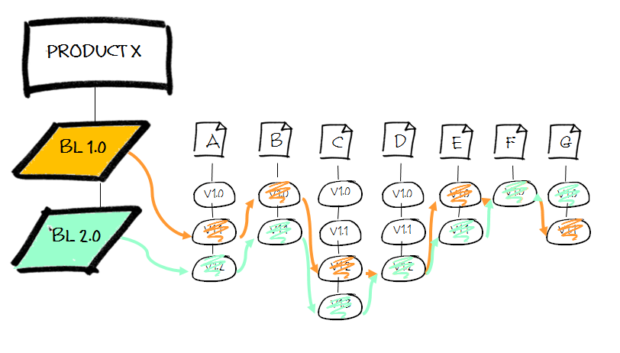
Illustration of a Baseline
Notes:
A baseline defines a set of files, each at a particular version. These need not be the latest (most recent) version. A baseline label uniquely identifies the configuration. Files may belong to one or more baselines.
In the example of Figure 12 baseline BL1.0 is the first baseline recorded. It consists of seven artefacts, each at a unique revision number. For this example, assume that BL1 records the most recent versions of each artefact. As development progresses each artefact is modified as required (that is, some artefact are modified, some are not). At some time later another baseline is taken – BL2.0. In this case BL2.0 records the current latest revisions of each file. Notice that artefact F is unchanged, so F v1.0 is included in both baseline BL1.0 and BL2.0.
In general each successive baseline contains more recent versions of files (but not always).

Slide 64
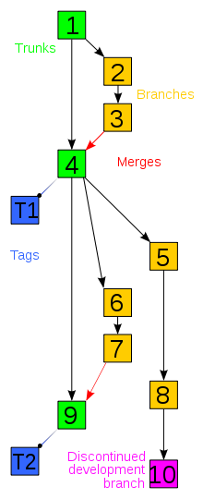
Branching, Merging and Labeling
Branching and Merging is the process of duplicating part of a software development project baseline so that some parallel development can take place. Then once completed it’s merged back into the baseline.
Label is kind of bookmark on the elements. All current versions of the elements are marked with label which makes it easy to retrieve elements later based on the label.
Label
Label
Notes:
Branching and Merging are two important aspects of version control. This concepts are extremely useful in parallel software development The two concepts are briefly explained below
Branch : It is a line of development that exists independently of another line, yet still shares a common history. For example assume we are developing a banking application for American customers. The same application can be used by Canadians with some customization. T he solution to this requirement can be achieved by creating a branch for the Canadian customers and incorporating the needed changes. Since the two branches are related , if any changes /bug fixes needed in both can be easily duplicated . The main line of development is called trunk (shown in the diagram), whereas a branch is a side line of a development
Merge : In simple terminologies a merge is basically “copying” the changes across branches . To quote an example , assume that we have started working on the next version of our product (version 4.0) . A critical bug and some minor customization is asked for . To accommodate we create a branch to incorporate change and deploy to the customer. Once the next release is ready we merge the branch completely so as to incorporate the changes done in the branch in the new version
Instructor Notes
This would be shown in the demo session of sv/tfs

Slide 65
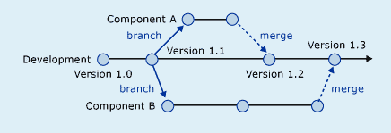
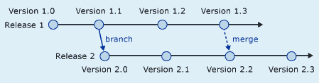
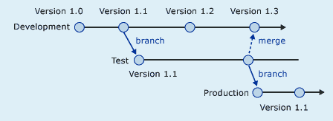
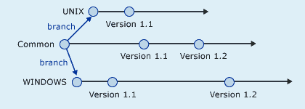
Different Ways of Branching
Branch per Release
Branch per Component
Branch per Promotion
Branch per Technology
Notes:
Branch per Release Every release is a new branch; common changes are merged between the releases. Branches are killed off only when the releases are no longer supported.
Branch per Component Each architectural component of the system is a new, independent branch. Components are merged into the main branch as they are completed.
Branch per Promotion
Every tier is a permanent branch. As changes are completed and tested, they pass the quality gate and are "promoted" as merges into successive tiers.
Branch per Technology Each technology platform is a permanent branch. Common parts of the codebase are merged between each platform.

Slide 66
SCM Tools
Tools help in managing projects better as it reduces a lot of manual effort
Early SCM tools had facilities for controlling and managing CI , but now it comes with a lot of features like
Build and Release management
Defect Management and tracking
Packaging control etc ..
Major advantages of SCM tools are
Sharing of project information across teams with accurate and reliable information,
Flexible in supporting parallel development
Provide better decision-making capability by managing and tracking

Slide 67

Different Roles and Accesses in SCM Tool
Administrator
All access to all project folders
Can add users, create and manage projects and modify their access levels
Configuration Manager
Greater access than all team-members.
Creates the basic environment for his projects configuration management
Responsible for moving files across projects, establishing baselines, adding requirements files, preparing guidelines, etc
Team-member
Varying access depending on their responsibilities. For e.g. PM gets add/modify access to Management project

Slide 68
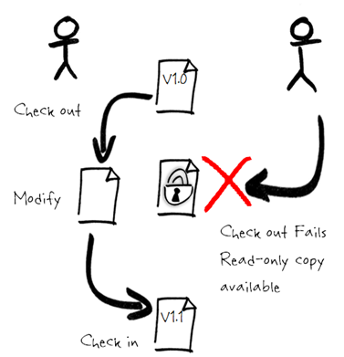
Check –in and Check -Out
A check-out is the act of creating a local working copy from the repository. A user may specify a specific revision or obtain the latest.
A check - in is the action of writing or merging the changes made in the working copy back to the repository.
Notes:
File locking
In a file locking system only one developer has write access to the artifact Other developers will have read-only access to the current (stored) version. The file is only available again once it is checked back in.

Slide 69
Test your understanding
SRS (System Requirement Specification) are prepared in which phase ?
A software can be built using more than 1 life cycle model . (T/F)
Name some non functional requirements
Architecture focuses on functional requirement T/F ?
Alpha testing and beta testing happens in which phase ?

Slide 70
Test Your Understanding!
In which phase UNIT Test Plan is written ?
White box testing includes
Unit Testing
System Testing
Operations Acceptance Testing
Integration testing
A single baseline may contain many files.(T/F)
A Tester can test in the development library.(T/F)

Slide 71
Introduction to Software Testing Life Cycle

Slide 72
What is Software Quality?
Quality is the totality of features and characteristics of a product or service that bear on its ability to satisfy stated and implied needs
Software Quality means:
Total conformance to user requirements and specifications
Absence of Defects
Fitness of Use

Slide 73
Other definitions
Errors:
Mistakes we make
Defects:
Defects are the results of errors
Failures:
Software failures are the results of Defects,
observed while running the software

Slide 74
Quality Assurance & Quality Control
Quality Control
Ensures that the product developed is correct
Detection and correction activity
E.g. Reviews and Testing
Carried out after initiation
Quality Assurance
Ensures that the product is developed correctly
Prevention activity
E.g. Process definition, planning
Done at the beginning of project

Slide 75
Importance of QA/QC
“All QC/QA activities are important, because all lead to quality software, if practiced correctly. However, if you allow me to choose one only, my choice is Formal Technical Reviews. If conducted properly, they are the single-most effective ways to uncover and fix defects while they are still inexpensive to find and fix.”
Roger Pressman

Slide 76
What is V&V?
Verification.
Determine whether the artifacts of each phase of SDLC fulfill the requirements of the previous phase.
Are we building the product correctly?
Also called as static technique or Review
Validation
Determine whether the artifacts of each phase of the SDLC are in tune with the customer requirements.
Are we building the correct product?
Also called as dynamic technique or Testing

Slide 77
Static and Dynamic V&V

Slide 78
Static and Dynamic Techniques
Static
Dynamic
Reviews
etc.
Behavioural
Inspection
Static Analysis
Walkthroughs
Structural
Non-functional
Functional
Desk-checking
etc.
etc.
Usability
Equivalence
Partitioning
Control
Flow
Data
Flow
Performance
etc.
Boundary
Value Analysis
etc.
Statement
Symbolic
Execution
Cause-Effect Graphing
Branch/Decision
Arcs
Random
Definition
-Use
Branch Condition
LCSAJ
Branch Condition Combination
State Transition
Capgemini Internal

Slide 79
Why V&V?
V&V is required because :
Software construction is a complex task.
Software construction is a Human activity
Humans make mistakes
Discipline and Methodology for construction reduce mistakes but cannot eliminate mistakes
V&V is about evaluating the products and processes used for producing the
products
V&V is NOT about evaluating the producers

Slide 80
Types of V&V
Reviews
Project Plans, Schedules, and Costs
Requirements, Functional Specifications, and Design
Test Plans, Test Specifications, Test Scripts,
Source Code
Testing of Software
Unit
Integration
System
Customer Acceptance

Slide 81
What is Life Cycle ?
Lifecycle in simple term refers to the sequence of changes from one form to other form
Every entity has a lifecycle from its inception to retire
In a similar way, Software is also an entity
Just like developing software involves a sequences of steps, testing also has steps which should be executed in a definite sequence
This phenomenon of executing the testing activities in a systematic and planned way is called testing life cycle

Slide 82
Software Testing Lifecycle
The full business, from initial thinking to final use, is called the product's life cycle."
--- Cem Kaner
“It is the preprocess, the process and post process involved in testing the Product.”
Notes:
Software Testing Life Cycle (STLC) is the testing process which is executed in systematic and planned manner. In STLC process, different activities are carried out to improve the quality of the product.

Slide 83
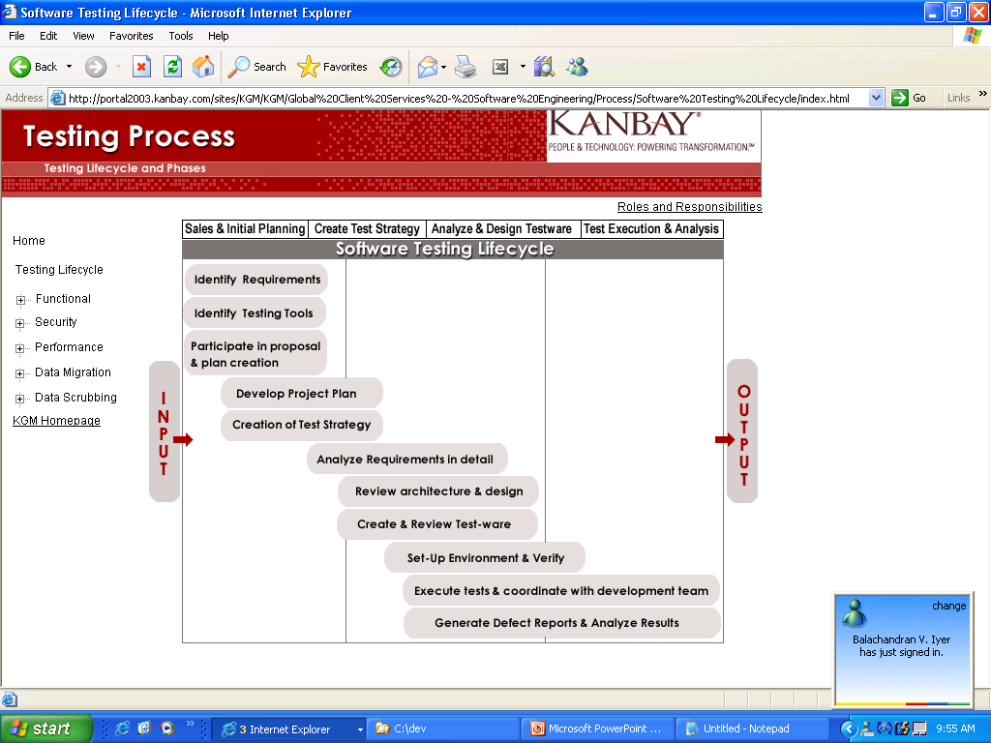
Software Test Life Cycle (STLC)

Slide 84
Different tasks involved in STLC
Software Testing Life Cycle is broadly classified into four types:
Task 1: Sales & Initial Planning
Task 2: Create Test Strategy
Task 3: Analyze & Design Testware
Task 4: Test Execution & Analysis
Notes:
Task 1: Sales and initial planning
During this phase of STLC, analyze and study the requirements. Have brain storming sessions with other teams and try to find out whether the requirements are testable or not.
In practical scenarios, Test planning is the first step of the testing process. In this phase we identify the activities and resources which would help to meet the testing objectives. During planning we also try to identify the metrics, the method of gathering and tracking those metrics.
Identify the need and feasibility of tools to be used based on project profitability, enhanced delivery capability and ease & effectiveness of testing.
Task 2: Create test strategy
A Test Strategy document is a high level document and normally developed by project manager and defines “Software Testing Approach” to achieve testing objectives. It sets the standards for testing processes and activities and other documents such as the Test Plan draws its contents from those standards set in the Test Strategy Document.
Task 3: Analyze and Design Testware
Analyse: Defines “WHAT” to be tested.
Design Testware: Defines “How” to test.
This is the most important stage of the testing life cycle, in this section or phase of the testing part; the testers will develop the test cases based against the requirements of the customer. There are usually three levels of requirements, to be understood by the testers before they can proceed to write the test cases for the product
HLI ( High level Information)
LLI / Use Cases ( Low level Information )
Snapshots (Prototype or images of a similar product or framework.)

Slide 85
Notes:
Task 4: Test Execution & Analysis
Test Execution - This is the phase where the test engineers will prepare and execute the test cases. One of the best techniques is to refer the use cases, pick up the standard test case templates and prepare test cases based on different categories. While do remember to maintain Traceability matrix alongside test execution to avoid rework and confusions at a later stage.
Analysis- It concentrates on the exit criteria and reporting after execution of test cases. Call out the testing team member meeting & evaluate cycle completion criteria based on Test coverage, Quality, Cost, Time, Critical Business Objectives, and Software. Discuss what all went good, which area needs to be improve & taking the lessons from current STLC as input to upcoming test cycles, which will help to improve bottleneck in the STLC process. Test case & bug report will analyze to find out the defect distribution by type and severity. Once complete the test cycle then test closure report & Test metrics will be prepared. Test result analysis to find out the defect distribution by type and severity. So Higher management people can take some decisions by analyzing these reports.

Slide 86
Different activities in each tasks
Lifecycle in simple term refers to the sequence of changes from one form to other form
Every entity has a lifecycle from its inception to retire
In a similar way, Software is also an entity
Just like developing software involves a sequences of steps, testing also has steps which should be executed in a definite sequence
This phenomenon of executing the testing activities in a systematic and planned way is called testing life cycle

Slide 87
Task 1: Sales & Initial Planning
‘Sales & Initial Planning’ in tune has three major activities like
Identify Requirements
Identify Testing Tool
Participate in proposal & plan creation

Slide 88
Task 1: Sales & Initial Planning - Identify Requirements
Details about this activity : This task ensure that requirements related to designing & performing software testing at various stages is adequately captured like,
Business and functional requirements
Non-functional requirements
Data related requirements
Environment related requirements

Slide 89
Task 1: Sales & Initial Planning - Identify Requirements
Roles and Responsibilities
Tasks to be perform by Test Manager with PM / Technical Architect / Business Analyst :
Identify testable and non testable items from requirements
Ensure all non functional requirements like Usability, Security, Reliability, Performance, Stress, transaction are captured
The data requirements for each level of testing and types of testing are captured
Verify if the production database at client has some sensitive data and information in it
Data structure & relationships are analyzed and the business rules associated with the tables & columns are to be captured
Identify how exceptions, errors and deviations are to be handled
Identify risks and assumptions and mitigation plan. Unanswered questions can be marked as pending until the project progresses
Obtain client sign-off on the requirements & baseline the requirement

Slide 90
Task 1: Sales & Initial Planning - Identify Testing Tool
Identify Testing Tools : Identify the need and feasibility of tools to be used based on project profitability, enhanced delivery capability and ease & effectiveness of testing.
Testing tools could be used for the following purposes:
Functional Testing
Performance Testing
Website Monitoring,
Data Generation
Data Upload
Defect Tracking
Application Security Testing
Data Migration testing

Slide 91
Task 1: Sales & Initial Planning - Identify Testing Tool
Details about this activity : Some of the tools should be chosen by default, e.g. Bug Tracking Tool, Unit Testing Tool, but the tool expert must consider the following:
Evaluate needs for testing tools
Impact of the tool usage on the cost/time and effort for the project
Infrastructure changes, licensing and availability of the tool to be accessed
Revise estimates for testing effort based on the tools selected
The deal team/ PM shall place a helpdesk request if tools have to be procured
Based on the timelines for availability of tools, project schedule & timelines may be revised

Slide 92
Task 1: Sales & Initial Planning - Participate in proposal & plan creation
Details about this activity:
The testing activities, effort estimates, cost estimates & milestones are determined based on the previous activities
These are now factored into the proposal to the client & an initial project plan is developed

Slide 93
Task 1: Sales & Initial Planning - Participate in proposal & plan creation
Roles and Responsibilities :
Tasks to be perform by test manager :
Estimate the testing effort & cost for the project and integrate the same with the overall project effort in the proposal
Identify the Size and roles of testing team, Major testing milestones, Hardware and Software requirements for testing and Data back-up & roll back facilities
Review the proposal using the proposal review checklist
Raise resource requisitions
Integrate all testing activities identified into the creation of phase one project plan

Slide 94
Task 2: Create Test Strategy
‘Create Test Strategy’ in tune has two major activities like :
Develop Detailed Project Plan
Creation of Test Strategy

Slide 95
Task 2: Create Test Strategy - Develop Detailed Project Plan
Develop Detailed Project Plan : Once the deal for the approval to go ahead with the project is obtained, detail planning needs to be executed.
Roles and Responsibilities :
Tasks to be perform by test manager along with PM:
Confirm the resource requisitions and raise a helpdesk request for hardware, software requirements etc.
Update the project plan periodically as and when there is any changes

Slide 96
Task 2: Create Test Strategy - Creation of Test Strategy
Details about this activity
Based on the technology, the level/type of testing and the results of the initial requirements analysis, specific testing deliverables which will become the basis for creating a test strategy need to be defined and use the available Test Strategy Templates.

Slide 97
Task 2: Create Test Strategy - Creation of Test Strategy
Roles and Responsibilities :
Some of the tasks to be perform like :
Set the testing objectives
Define scope based on the requirements
Identify the types of testing required
Determine the levels of testing involved in the project
Define Entry and Exit criteria
Define Test environment requirements with respect to test infrastructure requirements, test bed set up, configuration management process
Identify various cycles of testing
Identify the core functionality and the risk associated with it

Slide 98
Task 2: Create Test Strategy - Creation of Test Strategy
Identify Test Data Requirements, Test Procedures, Special Considerations and time to prepare test cases from several test scenarios, for all types of tests
Identify what and how the data will be scrubbed for functional and performance testing
Plan for test data and it source and the method for replicating data from the production environment, tools required for data creation
Identify the data requirements for integration and system, if required
Identify the test stubs and harness required plus how they should be designed
Identify how test results (test reports, defects raised) shall be reproduced

Slide 99
Task 3: Analyze and Design Testware
‘Analyze and Design Testware’ in tune has five major activities like :
Analyze and Detail Requirements
Review Architecture and Design
Design Testware
Review Design of Testware
Set Up Test Environment

Slide 100
Task 3: Analyze and Design Testware - Analyze and Detail Requirements
Details about this activity :
The main goal here is to understand and detail the requirements to be able to design and develop the Testware.
Any gaps in requirements, functional or non-functional should be identified & resolved at this stage

Slide 101
Task 3: Analyze and Design Testware - Analyze and Detail Requirements
Roles and Responsibilities :
Some tasks to be perform by Test Manager with PM / Technical Architect / Lead and Business Analyst :
Ensure that the requirements are complete, testable, comprehensive and consistent
Ensure that all aspects of requirements like functionality, usability, GUI, security, reliability, portability etc. are adequately detailed
Ensure that, based on the business processes, the performance testing team has created transaction and user profiles
Identifying the source, access, approximate volume and ways of generating data required, analyze the data requirements in detail for every level
Revisit the list of testable and non-testable items and make required changes if any

Slide 102
Task 3: Analyze and Design Testware - Analyze and Detail Requirements
Revisit the list of risks and assumptions identified during the initial requirements analysis
Identify gaps in the time, effort and cost estimation of the project between the initial requirement analysis and this detailed one
Adequately detail the data related requirements and responsibility to create test data is identified
Define methods/ life cycle to record, report & track test results. Define reports that will be generated on a periodic basis. Define approach to analyze the test results
For security testing, understand the application from both functionality and security perspective. Decompose the application. Ensure that for security testing different user profiles of an application are available to the tester
For data migration testing, data to be migrated has to be identified along with existing relationships & associated business rules

Slide 103
Task 3: Analyze and Design Testware - Review Architecture and Design
Details about each activity:
Review Architecture and Design
The objective is to ensure that the architecture & design are developed/provided and have adequately implemented all testing related requirements.
Ensure that the design is testable
In case of Object Oriented design the appointed architect from the testing team should review the elements of object-oriented software design that may cause testing problems. e.g. to limit the use of class inheritance, to limit the state behavior of objects, to avoid overly complex classes.
In the case of performance testing the aim is to convert non-functional requirements get converted into the appropriate design.
In case of application security testing the architecture/design that has been developed/provided should be sufficient to list or decompose into low level components.
The test lead along with the technical architect/ lead shall perform formal architecture/ design walk through to ensure traceability of test requirements into design and that the design is testable.

Slide 104
Task 3: Analyze and Design Testware - Design Testware
Details about this activity : Based on the scope of the project, analyze the requirements and design the Testware accordingly.
Key components of designing Testware include:
Design test cases, scripts & test scenario
Design test environment and libraries
Design test data and test stubs
Design test harness, if required Design methods to log, track, analyze and report test results

Slide 105
Task 3: Analyze and Design Testware - Design Testware
Roles and Responsibilities :
Tasks to be perform by test manger along with test lead :
Design test cases, scripts & scenario for Functional Testing, Performance Testing, Security Testing and Data Migration testing
Design test environment & libraries
Design test data and test stubs for different levels (Unit, Integration, System, UAT) and modes (manual/automated) of testing
Impact Analysis in case of existing Testware.
If the Testware already exists identify the impact of the new functionality on the existing Testware

Slide 106
Task 3: Analyze and Design Testware - Review Design of Testware
Details about this activity:
At least one level of formal review/walkthrough of all components of the Testware should be performed to ensure adequacy of test design & reduce rework
The peer review by the Business Analyst or the Domain expert as applicable. For Security testing the Team Lead would be responsible for reviewing the Testware
After all internal reviews have been completed get the test cases along with the test data reviewed by the client

Slide 107
Task 3: Analyze and Design Testware - Set Up Test Environment
Details about this activity:
Set Up Test Environment :
The configuration of test environment is detailed in the test strategy. Hardware is set up as per specifications, specific versions of software are installed and Databases are set up with initial data to be used for testing. All this is done to perform various levels & types of testing

Slide 108
Task 3: Analyze and Design Testware - Set Up Test Environment
Roles and Responsibilities :
Tasks perform by IT support and test lead :
Review & clarify the specifications for different test environment at various project locations (onsite/ offshore)
Install the necessary hardware and software
Set up databases as per specifications
Upload any initial test data if required
Set up testing tools, defect tracking tools
Test the setup of the environment at each location & address any issues

Slide 109
Task 4: Test execution and analysis
‘Test execution and analysis’ in tune has three major activities like :
Execute tests & coordinate with development team
Defect Reporting & Analyze Test Result
Considerations for independent Test Assignments

Slide 110
Task 4: Test execution and analysis - Execute tests & coordinate with development team
Details about this activity :
Execute tests & coordinate with development team :
Testing may be performed at various levels (unit, integration, system, UAT) at various project locations and with various types (functional, performance, usability, and security).
Typically unit testing is performed by the development team. Other types of testing may be performed by a separate testing team.
For such a situation formal procedures for handover should be defined and implemented. Similarly, a formal procedure should be defined and implemented for handover of the tested code, along with test results and status of defects detected.

Slide 111
Task 4: Test execution and analysis - Execute tests & coordinate with development team
Roles and Responsibilities :
Tasks to be perform by testers, test lead / manager & the team lead :
The team lead shall complete release notes and handover to the test lead to identify modules/ code to be tested
The test lead shall allocate tasks to the testers as per plan
Testers shall prepare for execution of the test. Specific data & further detailed test scenarios, scripts, test cases would have to be created. Cases may be prioritized for testing
Tester shall review the environment installation for completion
Testers shall execute the test, record the results and log defects using agreed upon tools

Slide 112
Task 4: Test execution and analysis - Execute tests & coordinate with development team
The team lead shall review the test results, analyze the code, and assign the open defects to developers. After the bug fixes, testing team have to perform another iteration of testing
The test lead shall verify the test results for accuracy, complete the release note and bug report. These are then handed over to the development team (client or Kanbay). If the reports have to be submitted to the client, then additional report providing the analysis of the test results shall be created.
All the above steps to be repeated until all tests are executed successfully with either zero defects or with an acceptable level of defects.

Slide 113
Task 4: Test execution and analysis - Defect Reporting & Analyze Test Result
Details about this activity:
Analysis in functional testing refers to identifying the defects, their causes, studying the defect patterns and analyzing them.
Consolidation of defects in the defect reports would primarily be the responsibility of the testing team while analyzing the causes of defects would be the responsibility of the development team.
Defect reports or Client reports also provide information to the development team/client on the quality of the product, stating the risks and issues faced during testing and making recommendations on the product quality and future testing process improvements.

Slide 114
Task 4: Test execution and analysis - Defect Reporting & Analyze Test Result
Roles and Responsibilities:
Tasks to be perform by Test Manager / Performance Analyst :
For Performance Testing – Analyze the Response Time per transaction, Transaction Response Time Distribution, Total Hits/Second and related graphs.
For Functional Testing -- Analyze the Test Results to determine defects, their priority and severity. If the testing activity is a part of development project being executed by Kanbay, root causes of defects should be determined along with the development team and fixes identified. In other cases this could be joint activity with the client team.
For Application security testing -- The threat maps will be populated that will show the coverage of threats tested for. A security threat report will be prepared which will list the vulnerabilities identified as well as some mitigation suggestions.
For Data Migration Testing -- Data in the target and source database are compared & validated post migration.

Slide 115
Task 4: Test execution and analysis - Considerations for independent Test Assignments
Details about this activity :
Considerations for independent Test Assignments :
For independent functional testing projects, performance testing projects or application security testing projects all the above workflows and phases are applicable. Certain upstream activities such as reviewing design, reviewing sample code to meet performance and security requirements and performing application tuning would be out of scope.

Slide 116
Test Your Understanding!
Question 1: Identify Requirements , Identify Testing Tool and Participate in proposal & plan creation are the activities of Create Test strategy.
True/ False
Question 2: Which of the following tasks to be performed by Test Manager with PM / Technical Architect / Lead and Business Analyst in analyze and Design Testware?
a) Ensure that the requirements are complete, testable, comprehensive and consistent
b) Set the testing objectives
c) Estimate the testing effort & cost for the project and integrate the same with the overall project effort in the proposal
d) All of the mentioned

Slide 117
Test Your Understanding!
Match the following :
1. Sales and Initial planning | A. Set-up Environment
2. Create Test Strategy | B. Execute tests and coordinate with development team
3. Analyze & Design Testware | C. Identify Requirements
4. Test Execution & Analysis | D. Develop Project Plan & create test strategy
Notes:
Answers:
C
D
A
B

